Slide 1

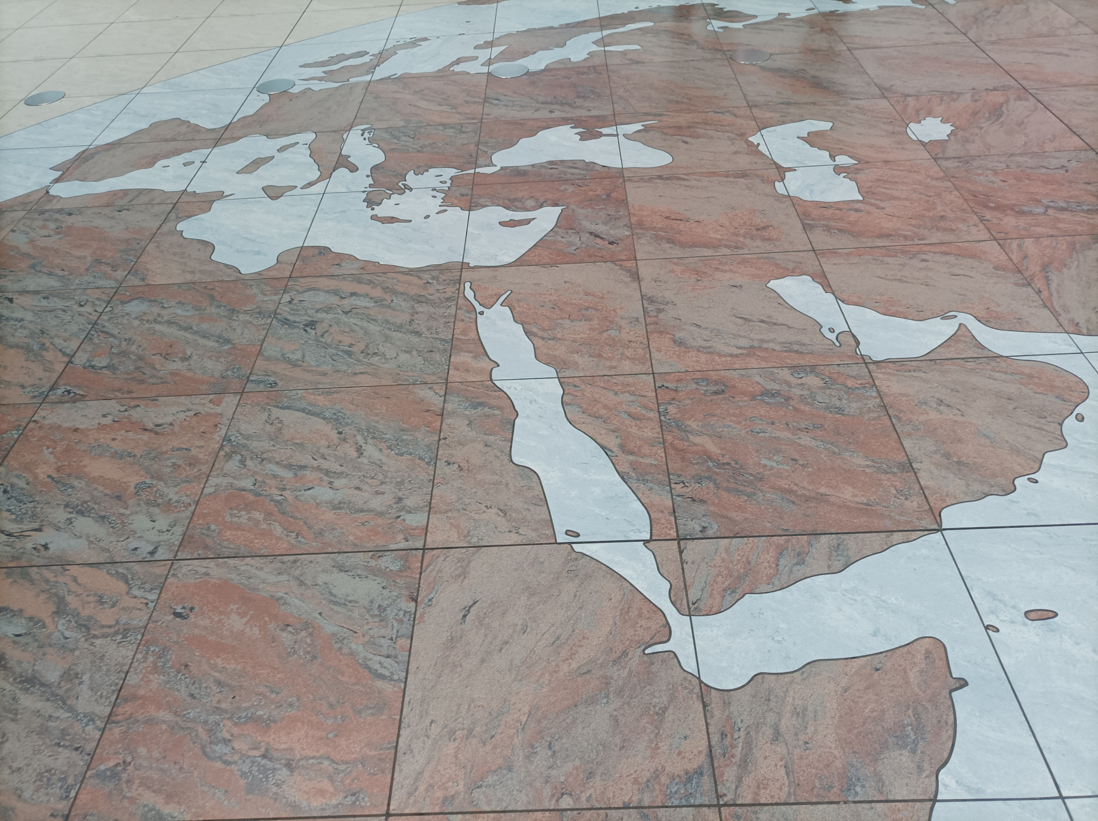
OGC API - Tiles
Tiles in the floor of the monument of discovery in Lisbon, Portugal.
(Lee Cannon April 2010, CC-BY-SA, https://www.flickr.com/photos/leecannon/5127274297)
Tiles in the floor of the terminal 2 of the Prague Airport, Czech Republic.
(Joan Masó, September 2022, CC0)

Slide 2




Tiles – Part 1: Core
GET
.../tiles
http://www.opengis.net/def/rel/ogc/1.0/tilesets-*
Access any data tiled based on 2D Tile Matrix Set
Map Tiles, Vector Tiles, Coverage Tiles...
Main Conformance Classes
Core
  Template based on tile Matrix, Row, Column
Tile Set
  Tile set described using standard metadata
Tile Sets list
  List of tile sets
GeoData Tile Sets List
  OGC API Common Collection-level list of tilesets
Dataset Tile Sets List
  OGC API Common Dataset-level list of tilesets
Server Response
List of tilesets
200
Formats Conformance Classes
PNG
JPEG
GeoTIFF
netCDF
GeoJSON
Mapbox Vector Tiles
(additional formats always allowed)
Additional Conformance Classes
Collection selection, Date and Time
Open API 3.0, XML

Slide 3
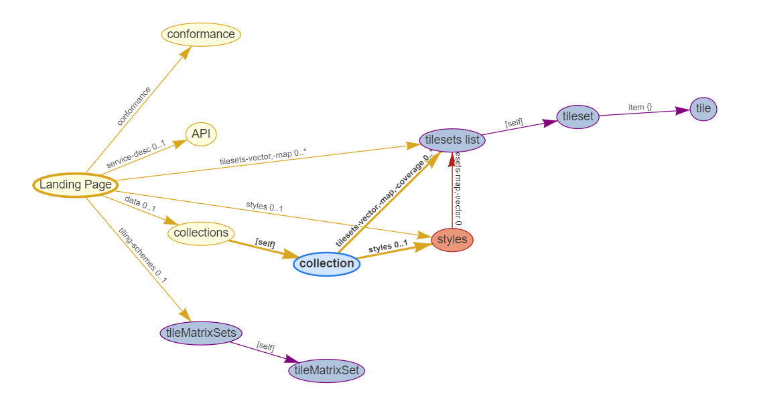
Following the links (resources & relation types)

Slide 4
Objectives for the sprint
Validate / update implementations against published OGC API – Tiles
Support development of test suite and new implementations
Technology Integration Experiments

Slide 5
Introduction (Tiles)
OGC API – Tiles
  Retrieve tiles from a geospatial data resource
  Resource could be a map, a dataset, a feature collection, a coverage, the output of a process or workflow...
  Could be data tiles (e.g. vector tiles, coverage tile) or map tiles
  Tile sets are defined using Tile Matrix Sets & TileSet Metadata
  A style could also be used to change the appearance (e.g. maps) or content (e.g. filtering for vector tiles) with OGC API – Styles
  Stand-alone or attached to Common, Maps, Coverages, Styles

Slide 6
Minimalist Core (Tiles)
A minimalist Core conformance class:
  Tiles retrievable according to some Tile Matrix Set definition
  A templated URL with variable identifiers should allow to express the path to individual tiles
  Example: {someAPI}/{column}/{row}/{level}.png
  In Core, no specific identifiers or order specified, but they correspond to the tile matrix (zoom level), tile row and tile column
  This enables most tile-based web mapping platform to conform
  No mechanism to communicate Tile Matrix Set definition or templated URL – done out of bounds via other OGC API – Tiles conformance classes, or other mechanism like Mapbox TileJSON

Slide 7
Tileset (Tiles)
Servers supporting Tileset conformance class defines a tileset according to the schema defined in TileMatrixSet & Tileset Metadata
  Specifies TileMatrixSet used for the tiles
    using tileMatrixSetURI if registered with OGC NA tile matrix set registry
    always have a [ogc-rel:tiling-scheme] link for TileMatrixSet definition
  Limits for each tile matrix sets, min / max tile matrix
  Layers making up the tiles; for vector/coverage tiles: properties schema
  Templated link (rel: "item") for tiles using {tileMatrix}, {tileRow} and {tileCol}
  Additional metadata about the tileset (e.g. dataType: map, coverage, vector)
  Example resource: {datasetAPI}/tiles/{tileMatrixSetId}

Slide 8
Tilesets List (Tiles)
Servers supporting Tilesets List conformance class list one or more tileset(s) available
  Relation types to link to a list of tilesets:
    http://www.opengis.net/def/rel/ogc/1.0/tilesets-map (map tiles)
    http://www.opengis.net/def/rel/ogc/1.0/tilesets-coverage (coverage tiles)
    http://www.opengis.net/def/rel/ogc/1.0/tilesets-vector (vector tiles)
  The list of tilesets resource consists of a tilesets key for which the value is an array of tilesets, each defined as per the same schema as for a single tileset, but featuring a minimal amount of information: tileMatrixSetURI / tileMatrixSetDefinition and dataType
  Each element in the list must contain link with rel: "self" to the tileset resource
  Example resource: {datasetAPI}/tiles

Slide 9
Tilesets Resources (Tiles)
{datasetAPI}/tiles
  Dataset tilesets (e.g. multi-layer vector tiles) (dataset-tilesets conf. class)
{datasetAPI}/map/tiles
  Dataset map tilesets (API – Maps map-tilesets conf. class)
{datasetAPI}/{collectionId}/tiles
  Collection data tilesets (e.g. vector tiles) (geodata-tilesets conf. class)
{datasetAPI}/{collectionId}/coverage/tiles
  Collection coverage tilesets (API - Coverages coverage-tilesets conf. class)
{datasetAPI}/{collectionId}/map/tiles
  Collection map tilesets (API – Maps map-tilesets conf. class)

Slide 10
Styled Tilesets Resources (Tiles)
{datasetAPI}/styles/{styleId}/tiles
  Styled dataset tilesets (e.g. multi-layer vector tiles)
{datasetAPI}/styles/{styleId}/map/tiles
  Styled dataset map tilesets
{datasetAPI}/styles/{styleId}/{collectionId}/tiles
  Styled collection data tilesets (e.g. vector tiles filtered by style)
{datasetAPI}/styles/{styleId}/{collectionId}/map/tiles
  Styled collection map tilesets

Slide 11
Data set tiles: selecting collections (Tiles)
Server may decide which collections to return by default
  It does not need to include all of them
collections query parameter allows client to select collections
  e.g. collections=AgricultureSrf,TransportationGroundCrv
For map tiles, the order in the collections list is default order
  A style may override this order (or even intertwine elements of those collections)

Slide 12
Query parameters (Tiles)
No parameter required: easily retrieve a tile
transparent
  (for Map tiles) useful for PNG, rendering individual layers to be composited
bgcolor
  (for Map tiles) specify a background color
datetime
  ISO 8601 date/time string
  One mechanism to support temporal datasets
subset
  For coverage tiles: can be used to subset (trim or slice) extra dimensions

Slide 13
Changes to TileMatrixSet
Repository: https://github.com/opengeospatial/2D-Tile-Matrix-Set/
TileMatrixSet schema
Both cellSize and scaleDenominator must be specified
identifier ⮕ id
boundingBox lowerCorner ⮕ lowerLeft, upperCorner ⮕ upperRight
No more type
New cornerOfOrigin [optional, default: topLeft]
topLeftCorner ⮕ pointOfOrigin (consistent with the conceptual model)

Slide 14
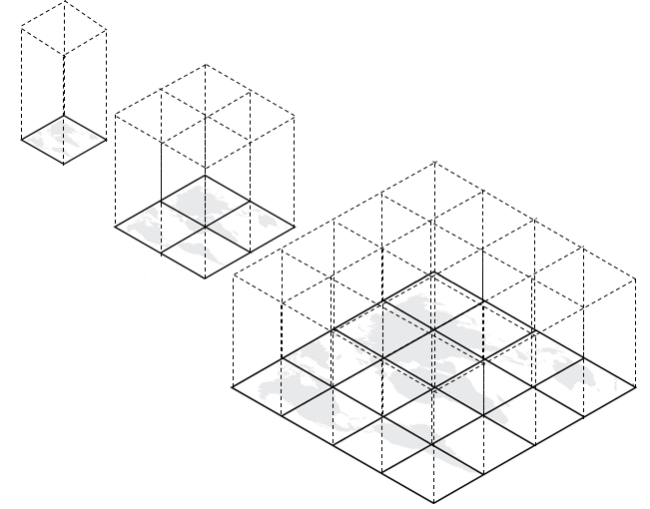
Extending TileMatrixSets to other dimensions
Extend in other dimensions; Use TMS as is, reduce content with level
Annex J of 2DTMS

Slide 15
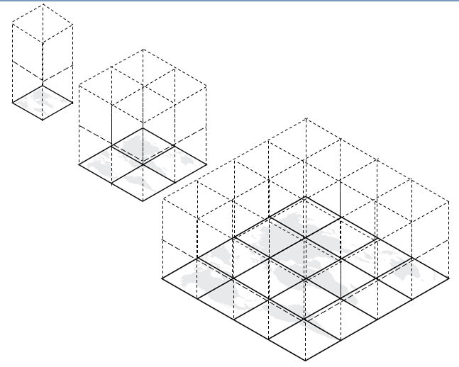
Extending TileMatrixSets to other dimensions
Add slices in other dimension (but overviews still based only on other dimensions)

Slide 16
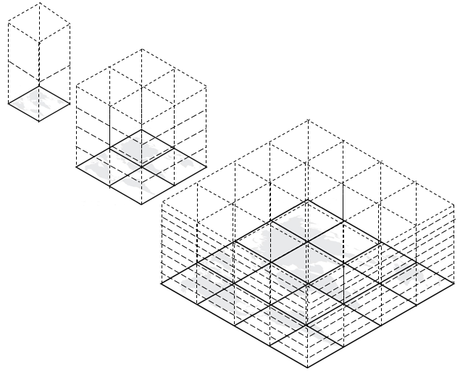
Extending TileMatrixSets to other dimensions
Change the number of slices in other dimension as well at lower levels
(turning into octree
or hyperoctree)

Slide 17
Community
500+ International Members
110+ Member Meetings
60+ Alliance and Liaison partners
50+ Standards Working Groups
45+ Domain Working Groups
25+ Years of Not for Profit Work
10+ Regional and Country Forums
Innovation
120+ Innovation Initiatives
380+ Technical reports
Quarterly Tech Trends monitoring
Standards
65+ Adopted Standards
300+ products with 1000+ certified implementations
1,700,000+ Operational Data Sets
Using OGC Standards
Contact info@ogc.org to schedule a meeting for an in-depth discussion with OGC staff and join our community today!
Notes:
If you have any questions, do not hesitate to reach out to OGC or schedule a follow-up. We’re working constantly to change the landscape of location information and want to help your organization get where it needs to go.

